Slide 1


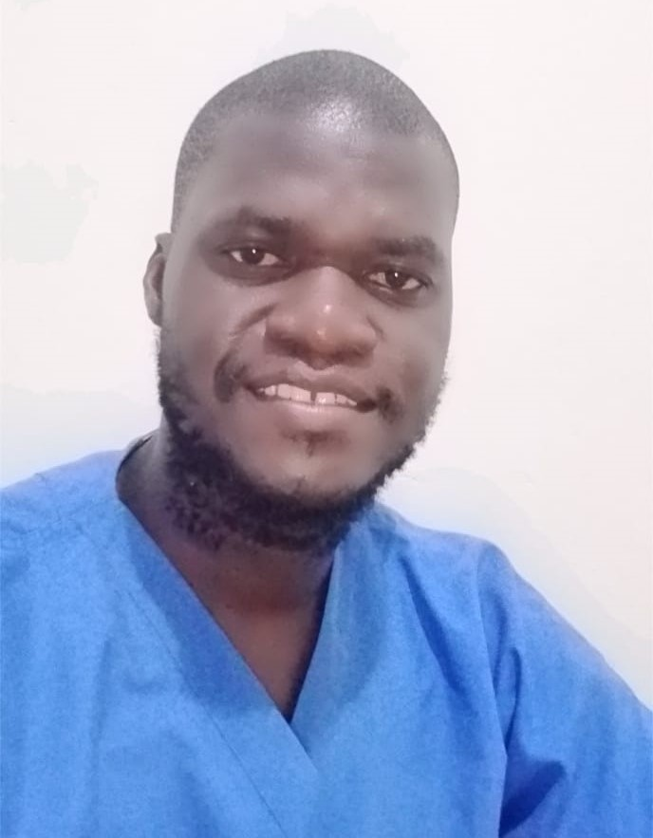
Assessment of Infection Prevention and Control Practices at Mother Amadea Mission Hospital Annex, Mikindani Estate, Mombasa Kenya
Achiando William Anyiko, Registered Clinical Officer
Mother Amadea Mission Hospital Annex
Head Shot

Slide 2
Background
Mother Amadea Mission Hospital Annex is a branch of Mother Amadea Hospital, its a Level 3 hospital offering outpatient services

Slide 3
Ethical Considerations and Study Approval
Study approval was granted by the continuous quality improvement committee. Informed consent was obtained from all participants, ensuring confidentiality and voluntary participation

Slide 4
Introduction:
Infection Prevention and Control (IPC) is crucial for ensuring patient safety and minimizing healthcare-associated infections. This study aims to assess IPC practices at Mother Amadea Mission Hospital Annex from February to June 2025.

Slide 5
Methodology
A mixed-methods approach was employed, integrating quantitative surveys and qualitative interviews. Structured questionnaires were distributed among healthcare workers, patients, and administrative staff to evaluate their knowledge, attitudes, and practices regarding IPC. Semi-structured interviews provided insights

Slide 6
Continuation
into barriers and facilitators affecting IPC implementation. Statistical analysis assessed the prevalence of IPC practices, while thematic analysis was used for qualitative data.

Slide 7
Results
Findings revealed that healthcare workers demonstrated a solid understanding of IPC principles, with 75% reporting regular hand hygiene. Among administrative staff, 70% recognized IPC policies, but only 50% felt adequately trained to enforce them. Additionally, 65% reported insufficient resource allocation for IPC initiatives. Patients expressed confidence in IPC measures (80%), yet 60% observed non-compliance with hand hygiene. Notably, 75% suggested improved communication about IPC practices during hospital visits.

Slide 8
Table: Summary of Key Findings
Category | Finding | Percentage
Healthcare Workers | Regular hand hygiene | 75%
Administrative Staff | Recognition of IPC policies | 70%
 | Feeling adequately trained to enforce IPC policies | 50%
 | Reporting insufficient resource allocation for IPC | 65%
Patients | Confidence in IPC measures | 80%
 | Observed non-compliance with hand hygiene | 60%
 | Suggested improved communication about IPC practices | 75%

Slide 9
Conclusion and Recommendations:
The results highlight the urgent need for enhanced IPC practices at Mother Amadea Mission Hospital Annex. Recommendations include ongoing training programs, improved resource allocation, and regular IPC committee meetings. Timely waste disposal and proper segregation, with clear labelling in Kiswahili and English, are essential improvements. Fostering a culture of safety and accountability among staff is vital for sustaining IPC advancements.

Slide 10
Acknowledgement
Mother Amadea Mission Hospital, Sr Veronica Wanjiru – Administrator, Dr Ocholi Don – Medical superintendent, Henry Ngeny – Ict, Kevin Mugo and Okoth Bernard-MAMHA

Slide 11
Thank You

